Slide 1

Mechatronic engineering Control systems in robotics
Structure Desing and POR,SOR Sistems
Manuel Alejandro Chalarca Botero
Jose Joaquin Restrepo Palacios

Slide 2

Plantilla para títulos 2

Slide 3
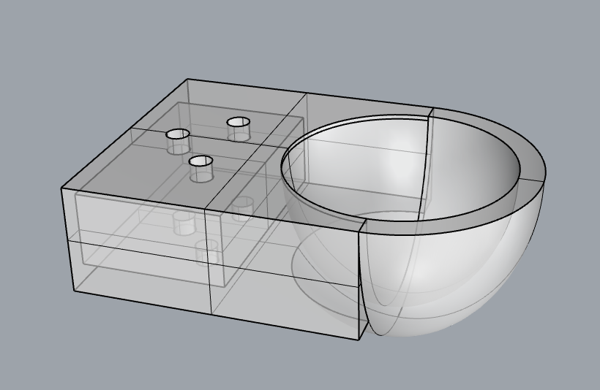
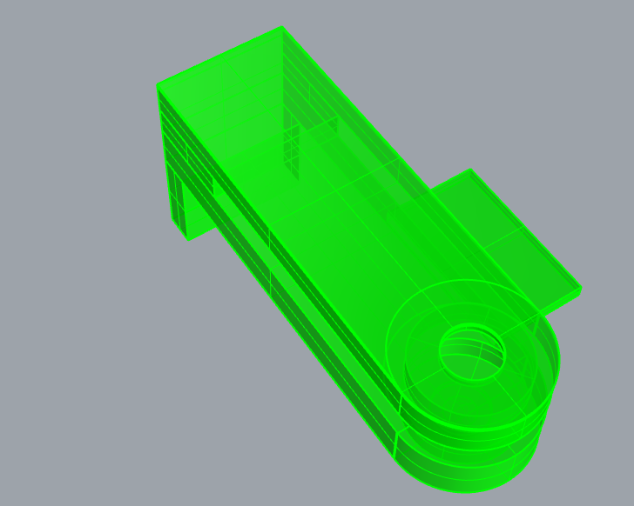
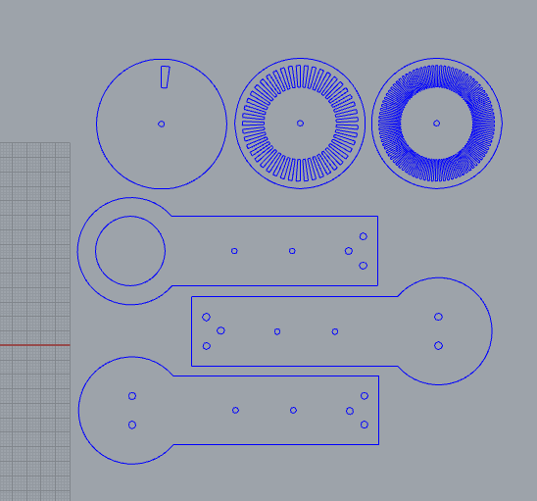
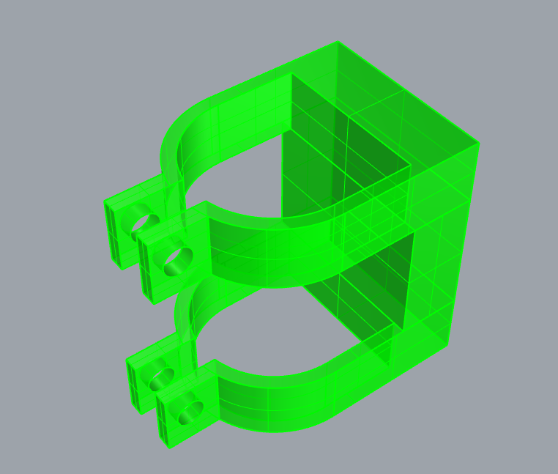
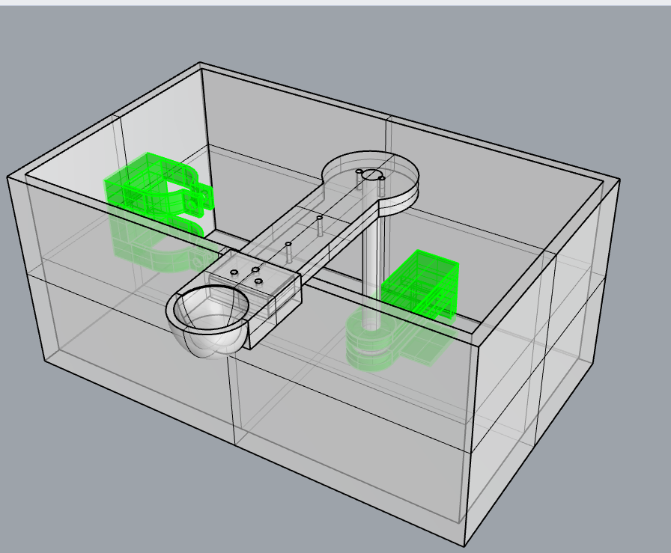
Hardware Desing
Fig 1, Arm Basket
Fig 2, Axis Support
Fig 5, Draw for Laser cutting
Fig 3, Motor Support
Fig 4, Mounted System

Slide 4
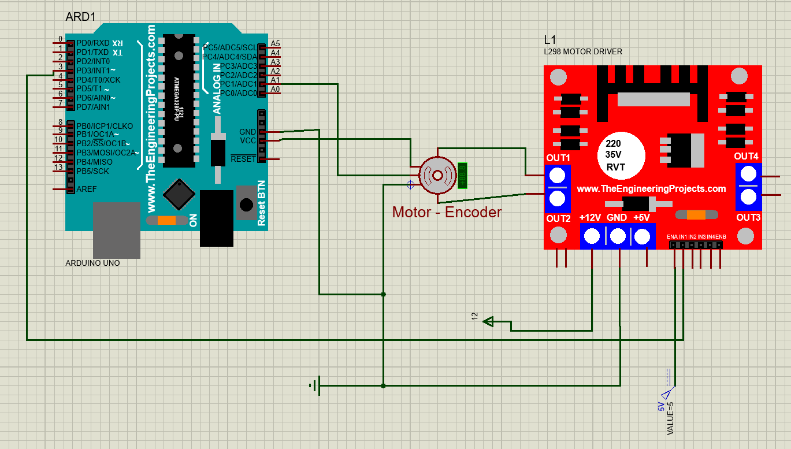
Fig 6, Electric Desing

Slide 5

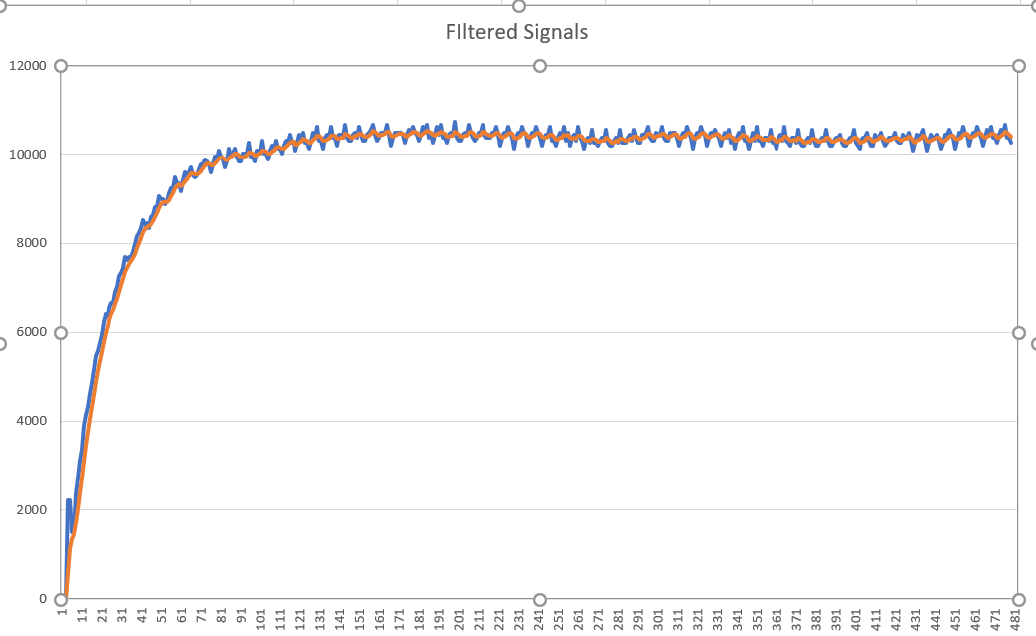
Data acquisition
Fig 7, Data comparation, Sampling time 5 milliseconds

Slide 6

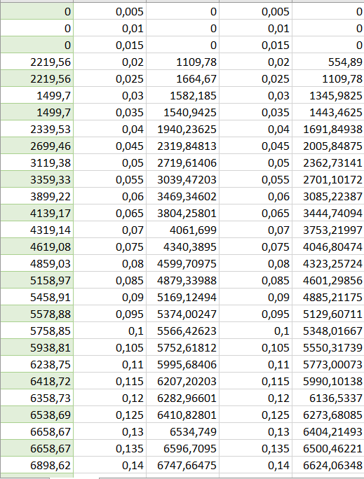
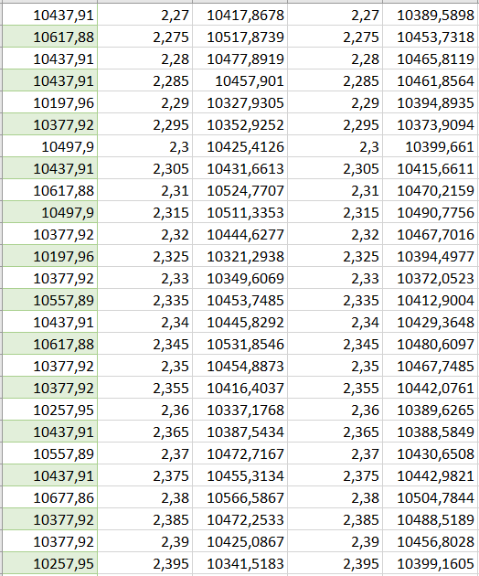
Fig 8, first 28 values and filtered values
Fig 9, last values and filtered values

Slide 7
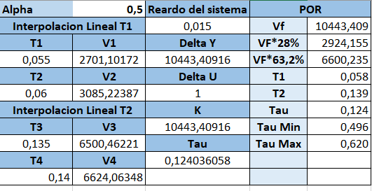
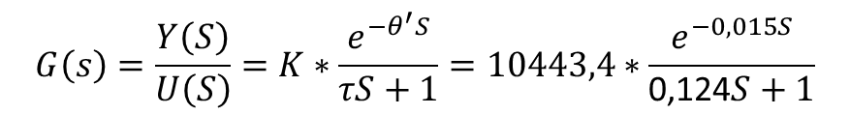
POR system
Fig 10, POR System Calculations
$$G\left(s\right)=\frac{Y\left(S\right)}{U\left(S\right)}=K∗\frac{e^{−θ^{′}S}}{τS+1}=10443,4∗\frac{e^{−0,015S}}{\text{0,124}S+1}$$

Slide 8

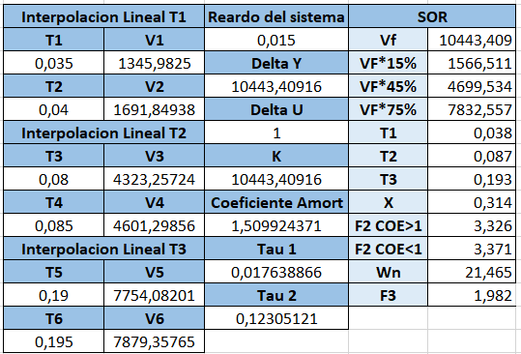
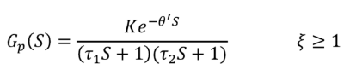

SOR System
Fig 11, SOR Calculations
$$G_{p}\left(S\right)=\frac{10443∗e^{−0,015S} }{(0,017S+1)(0,123S+1)}$$

Slide 9


